Slide 1
Lesson 4 Chapters 7-8
Tic-Tac-Toe Applet
Errors and Exceptions
UML

Slide 2
UML
Class Diagram

Slide 3
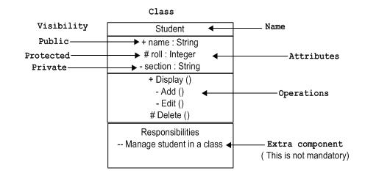
Class

Slide 4
Generalization – extends
Person
# name: String
A student has a name because
a student is a person
Student
- courses: Course[0..n]
A student attends a number of courses
Not every person does that
A student is a specific kind of person

Slide 5
Realization - Implements
<<Interface>>
Learner
+ learn(material: Material)
The line is dashed indicating
a weaker relationship.
A student is not only a learner
She is just able to learn
Intern
Student
One class can implement more than one interface

Slide 6
Association – Uses uni-directional
Course
Student
- students: Student[1..n]
The direction of the arrow indicates
who uses what.

Slide 7
Association - Uses bi-directional
If both classes uses each other
there is no arrow.
Teacher
1..n
1..200
Student
- students: Student[0..n]
- teachers: Teacher
1..10
Course
Cardinality

Slide 8
Association - Knows uni-directional
The book doesn’t know about
the student
Student
Book
- books: Book[0..n]
The line is dashed indicating a
weaker relationship

Slide 9
Association - Aggregation
Here uni-directional because the pages don’t know about the book.
Book
1..1000
Page
# pages: Page[1..1000]
The pages are part of the book
You would say that a book aggregates
pages.

